Slide 1
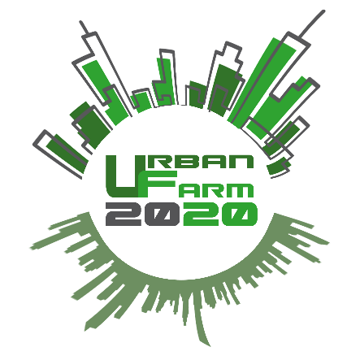
Precision farming in the framework of urban agriculture
Valda Rondelli
Department of Agricutlural and Food Sciences - DISTAL

Slide 2
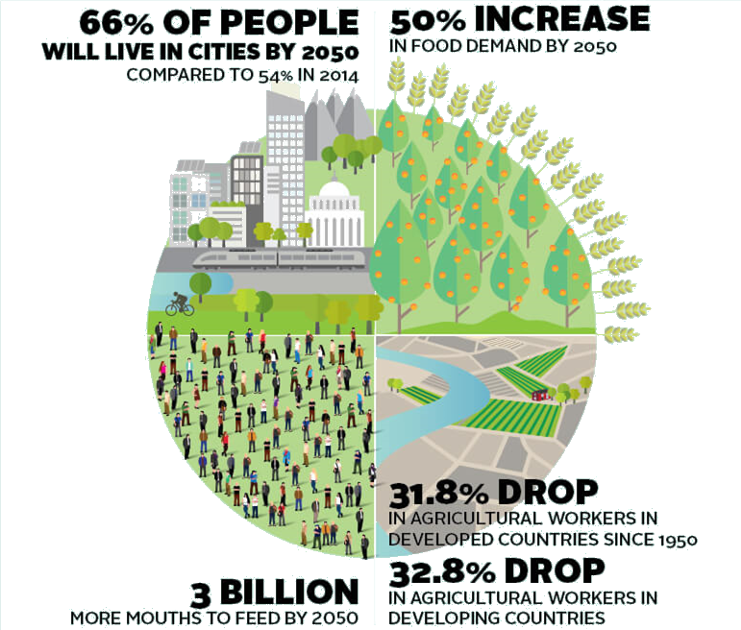
Source: FAO, https://www.gsb.stanford.edu/insights/future-food

Slide 3
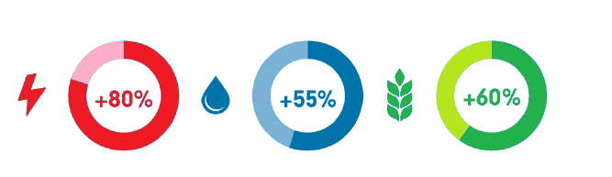
Source: FAO, https://www.gsb.stanford.edu/insights/future-food
Power/energy water Food

Slide 4
Urban agricolture and Smart cities
To positively affect the increase of food demand:
by transforming dismissed area into urban farms
by producing crops with water and nutrients and then re-using the water mixture to save money and the environment
by avoiding to transport crops (0 Km crops)
To obtain all these goals farm innovation is necessary

Slide 5
Precision farming/agriculture
Precision farming is a farming management concept based on observing, measuring and responding to inter and intra-field variability in crops.
Therefore precision agriculture attempts to manage variability within fields and crops
High cost of inputs including seeds, fertilizers, pesticides and fuel;
Environmental concerns about fertilizers and pesticides near sensitive areas, runoff and de-nitrification;
Technology has become available and economically feasible
As the seasons have a cycle, so does precision farming: data is collected from various sources, analyzed and used for decision making.
It is a systematic approach involving multiple technologies and multiple disciplines to make more informed decisions that can lead to greater profitability.

Slide 6
Precision agriculture by adopting innovation
Innovation to simplify operations and to increase the profitability of farms
The farmer today needs to:
  Optimize yields and control inputs
  Yields tracibility
  Complete tasks quickly
  Record and report all tasks carried out
  Reduce labor costs
How will they reach these goals?
  Connecting the activities of the entire crop cycle
  Reducing environmental impacts through sustainable agricultural practices
  Utilizing data to create informed decisions day-by-day minute-by-minute
Increasing the profitability
  Improving the use of all inputs and assets

Slide 7
Precision farming = managing variability
Prescription farming
Spatially variable agriculture
Site specific management
GPS farming
Farming by satellite
Variable rate application
Without having a reliable method of locating equipment and items in a field, it is difficult to manage in-field variability.
A reliable positioning method is needed to accurately locate field features to make precision agriculture work.
ISOBUS connection between tractor and equipment is then advisable together with equipment designed to perform a variable rate application according to areas need

Slide 8
Global Positioning System
The advent of GPS allowed for low-cost, reliable positioning of equipment in field. Data from other sensors could be tied to a specific point in the area with precision.
Satellites used as reference to calculate position
GPS receiver times radio signal from satellites
Time delay is the approach to measure distance to satellite
Requires 4 satellites for 3D position
  Latitude, Longitude, and Altitude (plus time of flight)

Slide 9
Precision agriculture Remote sensing
Remote sensing refers to any non-contact method of getting information about a particular aspect of a field/area: plant health, soil quality, topography, weed pressure etc.
Remote: operating from a distance
Sensing: detecting physical phenomena
Remote: as far away as a satellite or as close as a sensor attached to equipment/operator in the area that looks at individual plants.
The adoption of optical sensors is the most promising strategy for monitoring plant health and nutritional status to guide nutrition and protection of vegetables.

Slide 10
Optical sensors to monitor the health and nutritional status of a crop at plant level
Plant measurements represent a promising way for monitoring crop fertilizer requirement and/or crop protection needs in the growing season. Non-contact sensors.
Measurements should be precise, quick and possibly inexpensive.
Optical sensors and cameras are used for example to assess plant greenness, as correlated to the nitrogen content in the plant. Hand held and portable optical instruments are used to sense at individual leaf level and at the whole plant/canopy level; optical sensors on satellites and aircraft, helicopter, drones are for measurements of greater areas as fields, farms or regions.
These sensors allow for the definition of vegetation indexes and 3D geometry of the canopy.

Slide 11
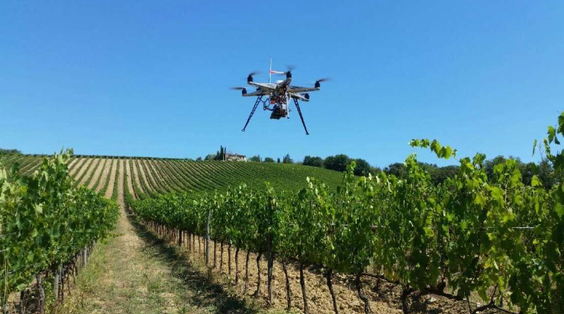
Aerial imagery by using a drone mounted with a digital camera

Slide 12
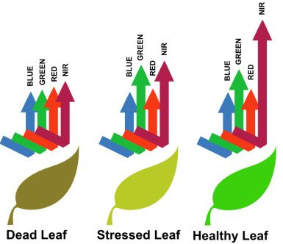
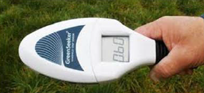
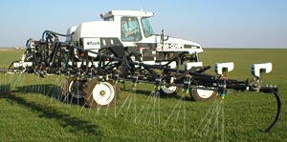
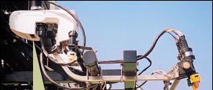
Optical tools from ground level
Mapping plant conditions with sensors that measure the reflected wavelenghts from plants or soil to measure several properties (vegetation indexes)
NTech GreenSeeker
To measure the leaf chlorophill content to deduce nitrogen concentration •
Green seeker Trimble
Ugelli applicano il fertilizzante nell’area in precedenza campionata

Slide 13


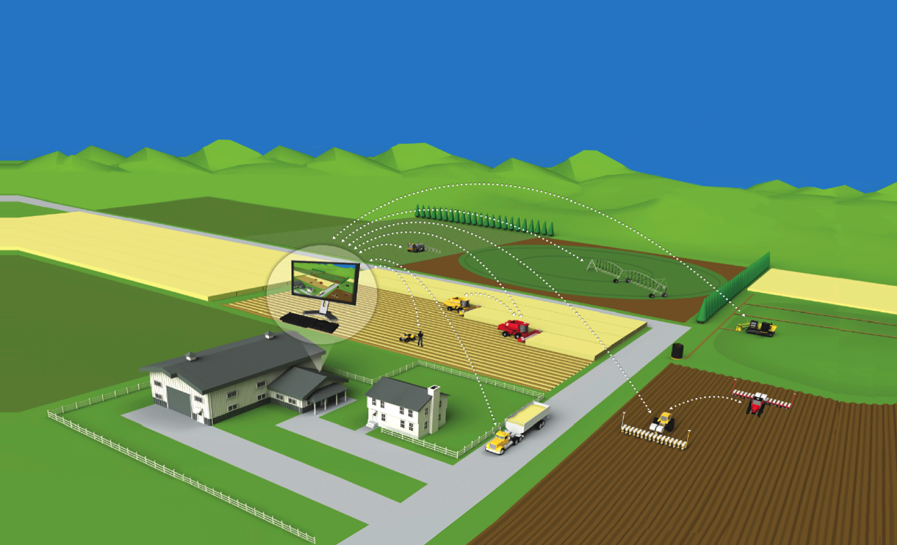












Farm 4.0
Rainfall
Crop
Remote
Imagery
Global
Positioning
Date
Smart
Sprayers
Field
Sensors
Precision
Irrigation
Water
eNDVI
Smart
Drainage
Full Farm
Management
Work Order Management
Smart
Harvesters
Soil
Enterprise
ERP
Mobile
Applications
Logistics
Tracking
Smart
Planters
Asset
Management
Mobile
Office
VR

Slide 14
Urban agriculture
In the context of urban agriculture the paradigm is different because there is no need to manage the variability within fields.
Therefore, among the main items of the precision farming, sensors and actuation systems are the ones to be implemented in the urban farms.
Optical, lidar, ultrasonic sensors and cameras have to be introduced in the urban farms to manage the nutrient supply and the plant protection with respect to the crop needs at each growth stage to optimize the nutrition and the crop healthyness (of course in addition to all sensors and actuation systems controlling the environmental conditions, the light, the water supply).
The aim is to have a dynamic management of the crops at the different growth stages to correlate all inputs to the achievable outputs, maximizing the economic and environmental sustainability.

Slide 15
Valda Rondelli
DISTAL
valda.rondelli@unibo.it

